Slide 1

GREYH@T
Georgia Tech

Slide 2
GreyH@t at gt
Teach the skills required to break things and the ethics necessary to wield them properly
Generate interest and raise awareness in cyber security
Win CTFs
Get you a job
To Learn

Slide 3
Who we ARE
Georgia Tech students of all levels
Undergrads
MS
PhD
Faculty and staff
GTRI
Industry
People who like to break things

Slide 4
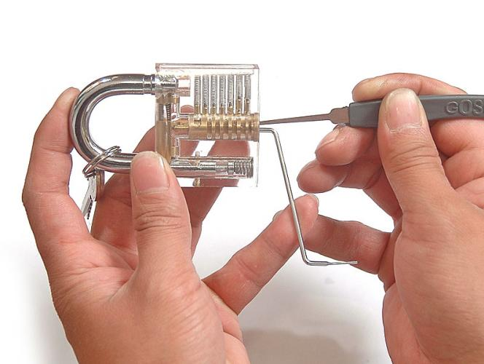

What do we do
Regular Meetings
Discuss security topics
Presentations from club members
Watch videos from conferences
Guest speakers
CTF Meetings
Theory/practical knowledge of offensive security
Compete
Hang out and have fun
Go to Events
DC404 Meetups
Conference visits

Slide 5
What will I learn?

Slide 6
Meetings
Thursdays: 6:30-8pm, CoC 17
Meetings Include:
News
Mini Tech Talks
Lectures
Demos
Tutorials
Exercises/Challenges
Company Visits

Slide 7

CTF
“Capture the Flag”
Security competition
Jeopardy Style
Attack and Defense
Learn theory of how vulns work
GreyH@tCTF
CTF Practice is Mondays from 7-8pm

Slide 8
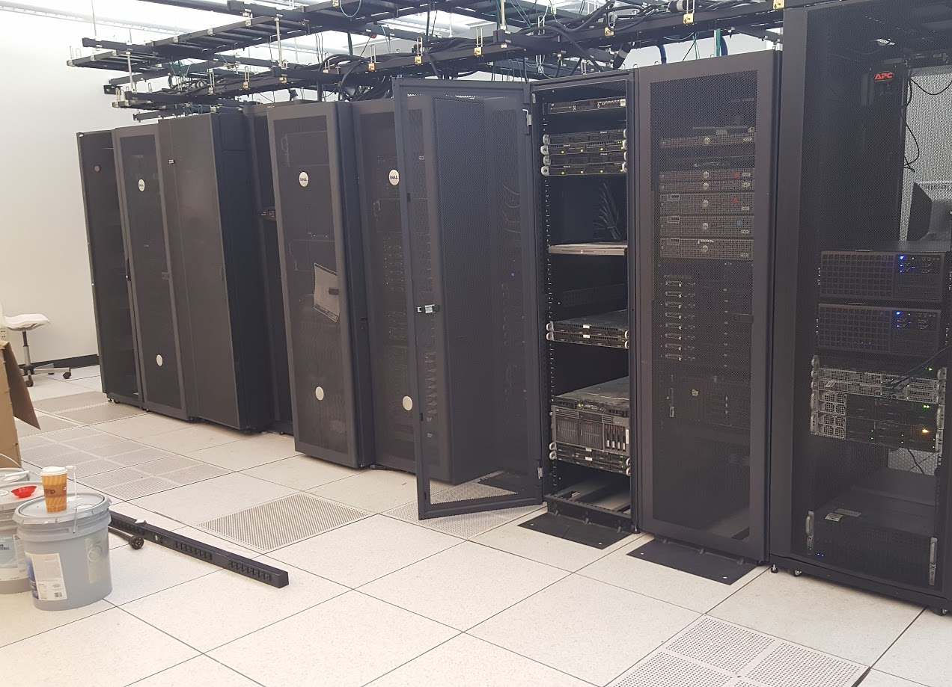
New this semester
Capture the Flag Server
New administrative structure
Web Site: https://greyhat.gatech.edu
Collaboration with LUG
Elections

Slide 9
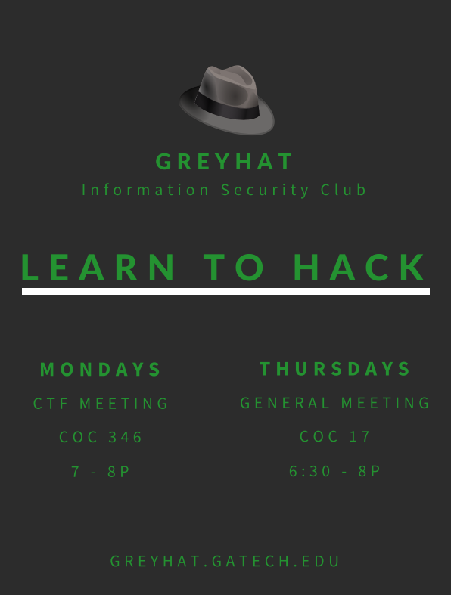
Communication
Get on our mailing list:
http://tinyurl.com/greyhatmailinglist
Check out our website:
https://greyhat.gatech.edu/
IRC
#thedeepestweb
#GreyH@t
Facebook Groups
GreyHat Information Security Club
GreyHat CTF

Slide 10
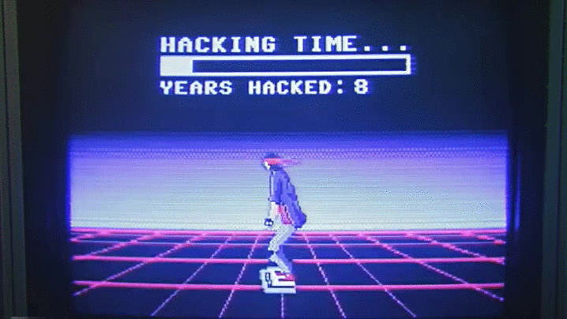
How to get involved
Hacked a video game? Done research in security? Work on a cool personal project? Learned something cool at a summer internship? Read about something cool?
Tell us about it!

